Slide 1


KAL Technology IT Consulting
Helping Business Take Their Software To The Next Level
GCP Compute SSH Self-Signed Certificate
Kirk S. Kalvar
Senior Software Engineer/Principal
www.kal.technology contact@kal.technology 844-930-2218

Slide 2
KAL Technology IT Consulting
GCP Compute SSH Self-Signed Certificate
With the advent of integrated development environments (IDE) such as AWS SageMaker Studio for Machine Learning (ML), it's now possible to provide a single integrated view where you can access purpose-built tools to perform tasks for preparing data to building, training, and deploying ML models. Kubeflow is an open source ML IDE where you can also access purpose-built tools to perform tasks for preparing data to building, training, and deploying your ML models, but run them on a Kubernetes cluster. Because it runs on Kubernetes its portable and scalable across multiple cloud and on premise infrastructure.
In this presentation we will provide a high-level architectural view of Kubeflow and then jump right into a lab to install Kubeflow on AWS.

Slide 3
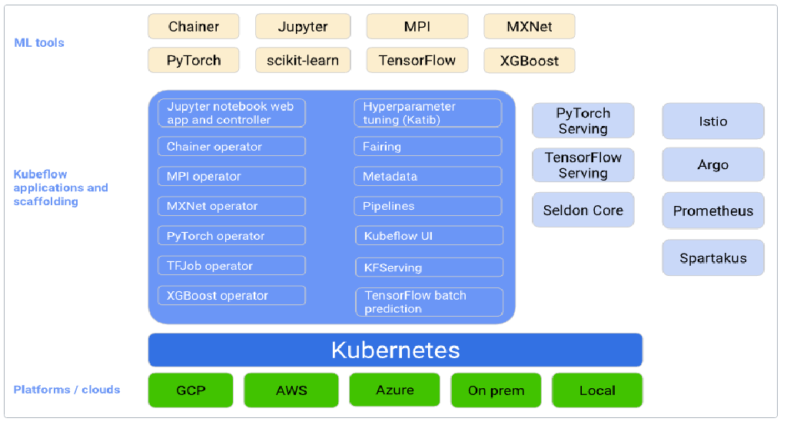
KAL Technology IT Consulting
Kubeflow Architecture

Slide 4
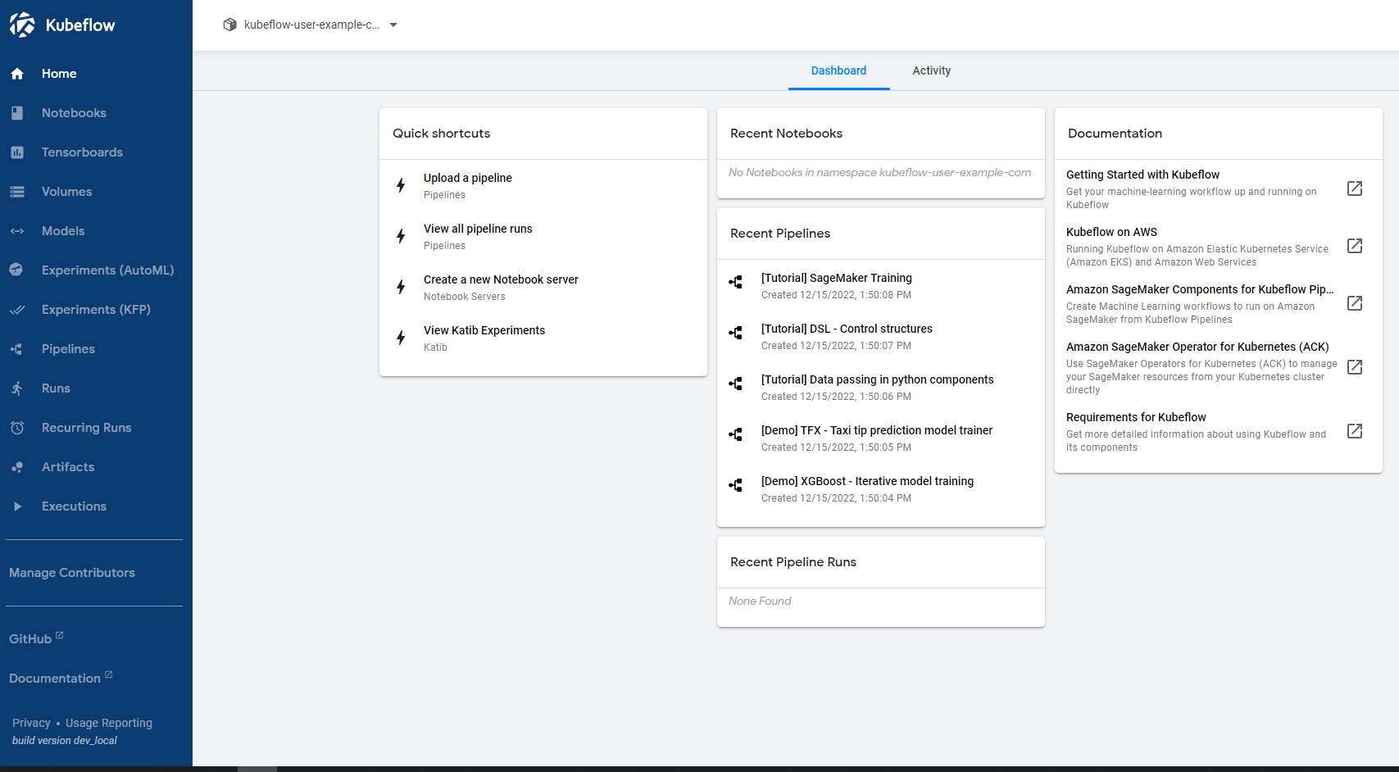
KAL Technology IT Consulting
Kubeflow Dashboard

Slide 5
KAL Technology IT Consulting
Lab Introduction:
In this lab we will install Kubeflow on AWS Elastic Kubernetes Service (EKS). Although I did find quite a few documents on installing Kubeflow on EKS, they were either confusing, inaccurate, or missing information.
It’s pretty hard to experiment and work with something new if you can’t get the basic service running. So I developed a reliable, repeatable process to get you up and running with Kubeflow quickly.
Please see “AWS Elastic Kubernetes Service (EKS) Kubeflow QuickStart” in the reference section at the bottom of this presentation. There’s a link to a GitHub project which contains step by step instructions you’ll need.

Slide 6
KAL Technology IT Consulting
Lab Prerequisites:
AWS Account
Ability to remotely ssh to an EC2 Instance

Slide 7
KAL Technology IT Consulting
References:
Kubeflow
https://www.kubeflow.org/docs
Kubeflow on AWS
https://awslabs.github.io/kubeflow-manifests/
AWS Elastic Kubernetes Service (EKS) Kubeflow QuickStart
https://github.com/kskalvar/aws-eks-kubeflow-quickstart

Slide 8
KAL Technology IT Consulting

